Slide 1
Arrays
Instructor: Mr. Khurram Iqbal

Slide 2
Opening Problem
Read one hundred numbers, compute their average, and find out how many numbers are above the average.

Slide 3
Introducing Arrays
Array is a data structure that represents a collection of the same types of data
Once an array is created, its size is fixed
An array reference variable is used to access the elements in an array using an index

Slide 4
Declaring Array Variables
datatype[] arrayRefVar;
Example:
double[] myList;
datatype arrayRefVar[]; // This style is allowed, but not preferred
Example:
double myList[];

Slide 5
Creating Arrays
Create an array by using the new operator and assign its reference to the variable
arrayRefVar = new datatype[arraySize];
(1) It creates an array using new elementType[arraySize];
(2) It assigns the reference of the newly created array to the variable arrayRefVar.
Example:
myList = new double[10];
myList[0] references the first element in the array.
myList[9] references the last element in the array.
new

Slide 6
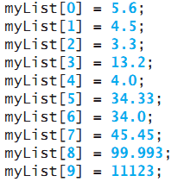
Declaring and Creating in One Step
datatype[] arrayRefVar = new datatype[arraySize];
double[] myList = new double[10];
datatype arrayRefVar[] = new datatype[arraySize];
double myList[] = new double[10];
To assign values to the elements:
arrayRefVar[index] = value;

Slide 7
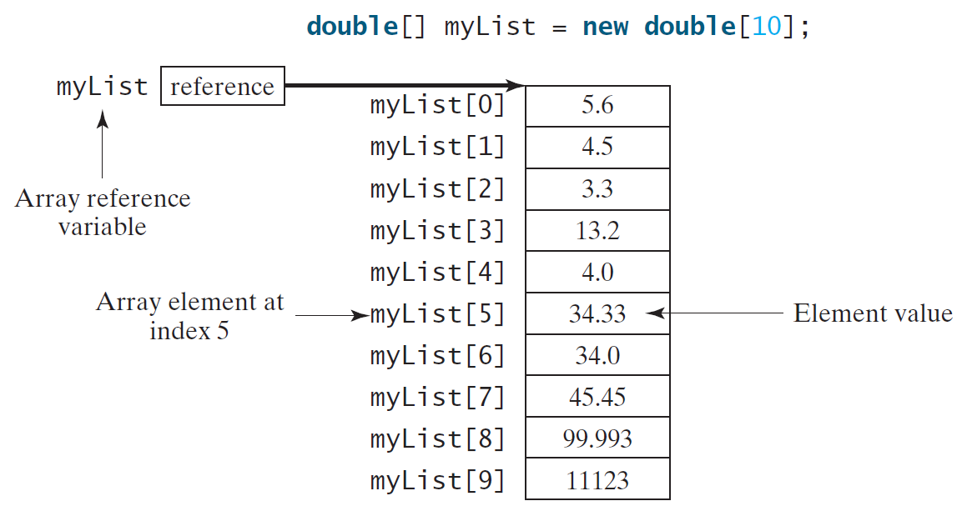
Creating Arrays

Slide 8
The Length of an Array
Once an array is created, its size is fixed. It cannot be changed. You can find its size using
arrayRefVar.length
For example,
myList.length returns 10

Slide 9
Default Values
When an array is created, its elements are assigned the default value of
0 for the numeric primitive data types,
'\u0000' for char types, and
false for boolean types.

Slide 10
Indexed Variables
The array elements are accessed through the index. The array indices are 0-based, i.e., it starts from 0 to arrayRefVar.length-1. In the example in Figure 6.1, myList holds ten double values and the indices are from 0 to 9.
Each element in the array is represented using the following syntax, known as an indexed variable:
arrayRefVar[index];

Slide 11
Using Indexed Variables
After an array is created, an indexed variable can be used in the same way as a regular variable. For example, the following code adds the value in myList[0] and myList[1] to myList[2].
myList[2] = myList[0] + myList[1];

Slide 12
Declaring, creating, initializing Using the Shorthand Notation
double[] myList = {1.9, 2.9, 3.4, 3.5};
- This shorthand syntax must be in one statement.
This shorthand notation is equivalent to the following statements:
double[] myList = new double[4];
myList[0] = 1.9;
myList[1] = 2.9;
myList[2] = 3.4;
myList[3] = 3.5;

Slide 13
Processing Arrays
(Initializing arrays with input values)
(Initializing arrays with random values)
(Printing arrays)
(Summing all elements)
(Finding the largest element)
(Finding the smallest index of the largest element)
(Random shuffling)
(Shifting elements)

Slide 14
Initializing arrays with input values
java.util.Scanner input = new java.util.Scanner(System.in);
System.out.print("Enter " + myList.length + " values: ");
for (int i = 0; i < myList.length; i++)
myList[i] = input.nextDouble();

Slide 15
Initializing arrays with random values
for (int i = 0; i < myList.length; i++) {
myList[i] = Math.random() * 100;
}

Slide 16
Printing arrays
for (int i = 0; i < myList.length; i++) {
System.out.print(myList[i] + " ");
}

Slide 17
Summing all elements
double total = 0;
for (int i = 0; i < myList.length; i++) {
total += myList[i];
// total = total+ myList[i]
}

Slide 18
Finding the largest element
double max = myList[0];
for (int i = 1; i < myList.length; i++) {
if (myList[i] > max)
max = myList[i];
}

Slide 19
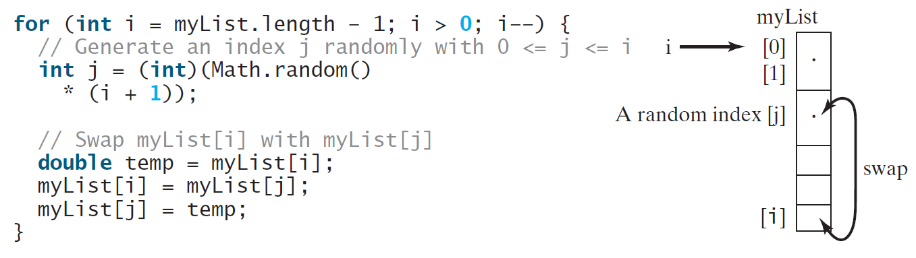
Random shuffling

Slide 20
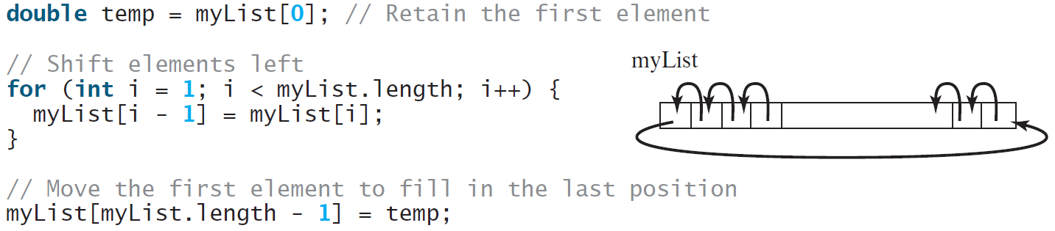
Shifting Elements

Slide 21
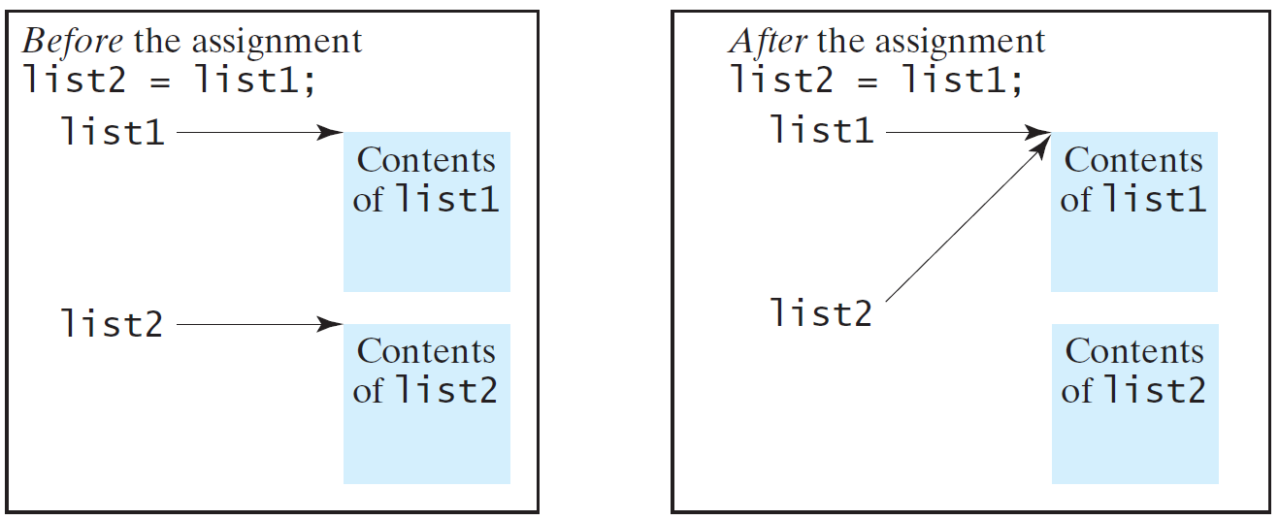
Copying Arrays
Often, in a program, you need to duplicate an array or a part of an array. In such cases you could attempt to use the assignment statement (=), as follows:
list2 = list1;

Slide 22
Copying Arrays
To copy the contents of one array into another, you have to copy the array’s individual elements into the other array
Using a loop:
int[] sourceArray = {2, 3, 1, 5, 10};
int[] targetArray = new int[sourceArray.length];
for (int i = 0; i < sourceArrays.length; i++)
targetArray[i] = sourceArray[i];

Slide 23
The arraycopy Utility
arraycopy(sourceArray, src_pos, targetArray, tar_pos, length);
srcPos and tarPos indicate the starting positions in sourceArray and targetArray, respectively
length number of elements copied from sourceArray to targetArray
Example:
System.arraycopy(sourceArray, 0, targetArray, 0, sourceArray.length);

Slide 24
Passing Arrays to Methods
When passing an array to a method, the reference of the array is passed to the method.
public static void printArray(int[] array) {
for (int i = 0; i < array.length; i++) {
System.out.print(array[i] + " ");
}
}
Invoke the method
int[] list = {3, 1, 2, 6, 4, 2};
printArray(list);
Anonymous Array
printArray(new int[]{3, 1, 2, 6, 4, 2});

Slide 25
Pass By Value
Java uses pass by value to pass arguments to a method. There are important differences between passing a value of variables of primitive data types and passing arrays.
For a parameter of a primitive type value, the actual value is passed. Changing the value of the local parameter inside the method does not affect the value of the variable outside the method.
For a parameter of an array type, the value of the parameter contains a reference to an array; this reference is passed to the method. Any changes to the array that occur inside the method body will affect the original array that was passed as the argument.

Slide 26
Simple Example
public class Test {
public static void main(String[] args) {
int x = 1; // x represents an int value
int[] y = new int[10]; // y represents an array of int values
m(x, y); // Invoke m with arguments x and y
System.out.println("x is " + x);
System.out.println("y[0] is " + y[0]);
}
public static void m(int number, int[] numbers) {
number = 1001; // Assign a new value to number
numbers[0] = 5555; // Assign a new value to numbers[0]
}
}

Slide 27
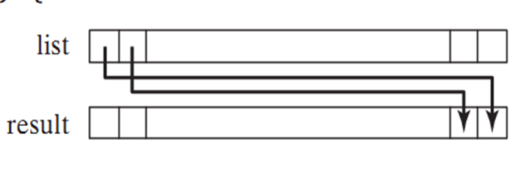

Returning an Array from a Method
When a method returns an array, the reference of the array is returned

Slide 28
Variable-Length Argument Lists
A variable number of arguments of the same type can be passed to a method and treated as an array.
You can pass a variable number of arguments of the same type to a method
Syntax: typeName... parameterName
Java treats a variable-length parameter as an array
Only one variable-length parameter may be specified in a method, and this parameter must be the last parameter
Any regular parameters must come before it.
public static void varLengthMethod(double a,int...n)

Slide 29
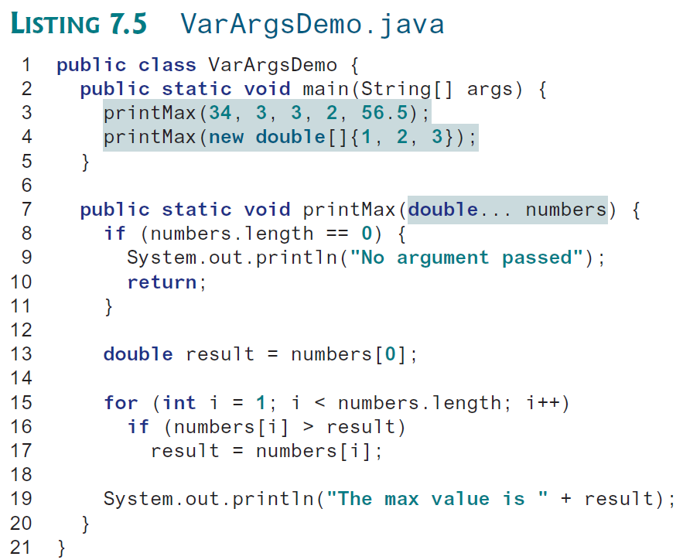

Slide 30
Searching Arrays
Searching is the process of looking for a specific element in an array; for example, discovering whether a certain score is included in a list of scores. Searching is a common task in computer programming. There are many algorithms and data structures devoted to searching. In this section, two commonly used approaches are discussed, linear search and binary search.

Slide 31
Searching Arrays
public class LinearSearch {
/** The method for finding a key in the list */
public static int linearSearch(int[] list, int key) {
for (int i = 0; i < list.length; i++)
if (key == list[i])
return i;
return -1;
}
}

Slide 32
Linear Search
The linear search approach compares the key element, key, sequentially with each element in the array list. The method continues to do so until the key matches an element in the list or the list is exhausted without a match being found. If a match is made, the linear search returns the index of the element in the array that matches the key. If no match is found, the search returns -1.

Slide 33
Linear Search Animation
Key
List
3
6 | 4 | 1 | 9 | 7 | 3 | 2 | 8
3
6 | 4 | 1 | 9 | 7 | 3 | 2 | 8
3
6 | 4 | 1 | 9 | 7 | 3 | 2 | 8
3
6 | 4 | 1 | 9 | 7 | 3 | 2 | 8
3
6 | 4 | 1 | 9 | 7 | 3 | 2 | 8
3
6 | 4 | 1 | 9 | 7 | 3 | 2 | 8

Slide 34
From Idea to Solution
/** The method for finding a key in the list */
public static int linearSearch(int[] list, int key) {
for (int i = 0; i < list.length; i++)
if (key == list[i])
return i;
return -1;
}
Trace the method
int[] list = {1, 4, 4, 2, 5, -3, 6, 2};
int i = linearSearch(list, 4); // returns 1
int j = linearSearch(list, -4); // returns -1
int k = linearSearch(list, -3); // returns 5

Slide 35
Binary Search
For binary search to work, the elements in the array must already be ordered. Without loss of generality, assume that the array is in ascending order.
e.g., 2 4 7 10 11 45 50 59 60 66 69 70 79
The binary search first compares the key with the element in the middle of the array.

Slide 36
Binary Search, cont.
Consider the following three cases:
If the key is less than the middle element, you only need to search the key in the first half of the array.
If the key is equal to the middle element, the search ends with a match.
If the key is greater than the middle element, you only need to search the key in the second half of the array.

Slide 37
Binary Search
Key
List
8
1 | 2 | 3 | 4 | 6 | 7 | 8 | 9
8
1 | 2 | 3 | 4 | 6 | 7 | 8 | 9
8
1 | 2 | 3 | 4 | 6 | 7 | 8 | 9

Slide 38
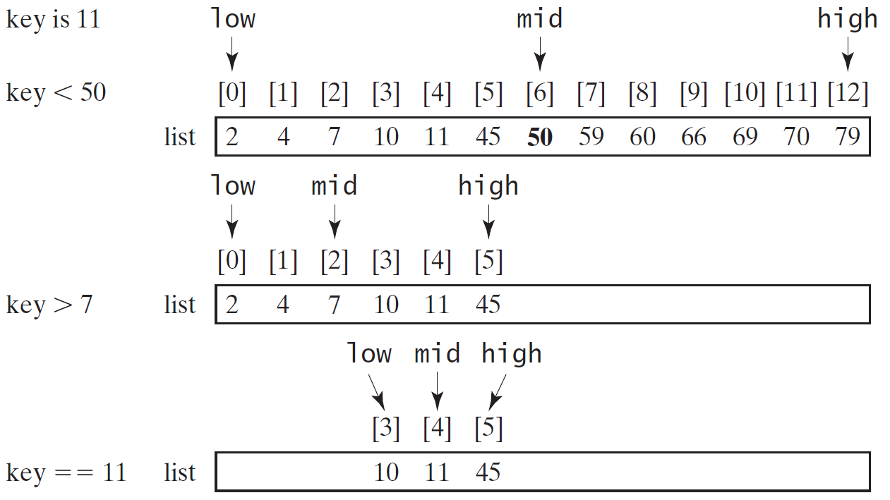
Binary Search, cont.

Slide 39
Binary Search, cont.

Slide 40
Binary Search, cont.
The binarySearch method returns the index of the element in the list that matches the search key if it is contained in the list. Otherwise, it returns
-insertion point - 1.
The insertion point is the point at which the key would be inserted into the list.

Slide 41
From Idea to Solution
/** Use binary search to find the key in the list */
public static int binarySearch(int[] list, int key) {
int low = 0;
int high = list.length - 1;
while (high >= low) {
int mid = (low + high) / 2;
if (key < list[mid])
high = mid - 1;
else if (key == list[mid])
return mid;
else
low = mid + 1;
}
return -1 - low;
}

Slide 42
The Arrays.binarySearch Method
Since binary search is frequently used in programming, Java provides several overloaded binarySearch methods for searching a key in an array of int, double, char, short, long, and float in the java.util.Arrays class. For example, the following code searches the keys in an array of numbers and an array of characters.
int[] list = {2, 4, 7, 10, 11, 45, 50, 59, 60, 66, 69, 70, 79};
System.out.println("Index is " +
java.util.Arrays.binarySearch(list, 11));
char[] chars = {'a', 'c', 'g', 'x', 'y', 'z'};
System.out.println("Index is " +
java.util.Arrays.binarySearch(chars, 't'));
For the binarySearch method to work, the array must be pre-sorted in increasing order.
Return is 4
Return is –4 (insertion point is 3, so return is -3-1)

Slide 43
Sorting Arrays
Sorting, like searching, is also a common task in computer programming. Many different algorithms have been developed for sorting. This section introduces a simple, intuitive sorting algorithms: selection sort.

Slide 44
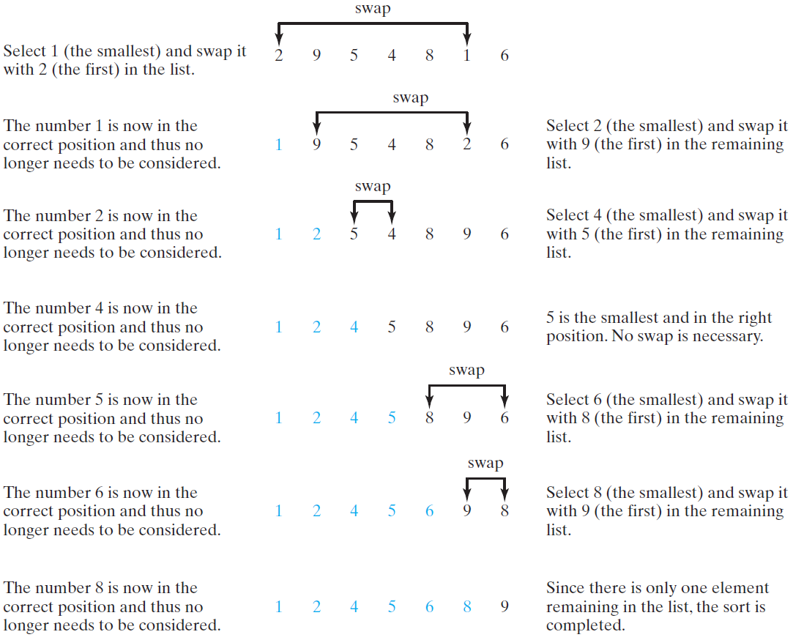
Selection Sort
Selection sort finds the smallest number in the list and places it first. It then finds the smallest number remaining and places it second, and so on until the list contains only a single number.

Slide 45
Wrap it in a Method
/** The method for sorting the numbers */
public static void selectionSort(double[] list) {
for (int i = 0; i < list.length; i++) {
// Find the minimum in the list[i..list.length-1]
double currentMin = list[i];
int currentMinIndex = i;
for (int j = i + 1; j < list.length; j++) {
if (currentMin > list[j]) {
currentMin = list[j];
currentMinIndex = j;
}
}
Invoke it
selectionSort(yourList)

Slide 46
The Arrays.sort Method
Since sorting is frequently used in programming, Java provides several overloaded sort methods for sorting an array of int, double, char, short, long, and float in the java.util.Arrays class. For example, the following code sorts an array of numbers and an array of characters.
double[] numbers = {6.0, 4.4, 1.9, 2.9, 3.4, 3.5};
java.util.Arrays.sort(numbers);
char[] chars = {'a', 'A', '4', 'F', 'D', 'P'};
java.util.Arrays.sort(chars);

Slide 47
The Arrays.toString(list) Method
The Arrays.toString(list) method can be used to return a string representation for the list.

Slide 48
Main Method Is Just a Regular Method
You can call a regular method by passing actual parameters. Can you pass arguments to main? Of course, yes. For example, the main method in class B is invoked by a method in A, as shown below:

Slide 49
Command-Line Parameters
class TestMain {
public static void main(String[] args) {
...
}
}
java TestMain arg0 arg1 arg2 ... argn

Slide 50
Processing Command-Line Parameters
In the main method, get the arguments from args[0], args[1], ..., args[n], which corresponds to arg0, arg1, ..., argn in the command line.
Notes:
Example 12.4

